Slide 1
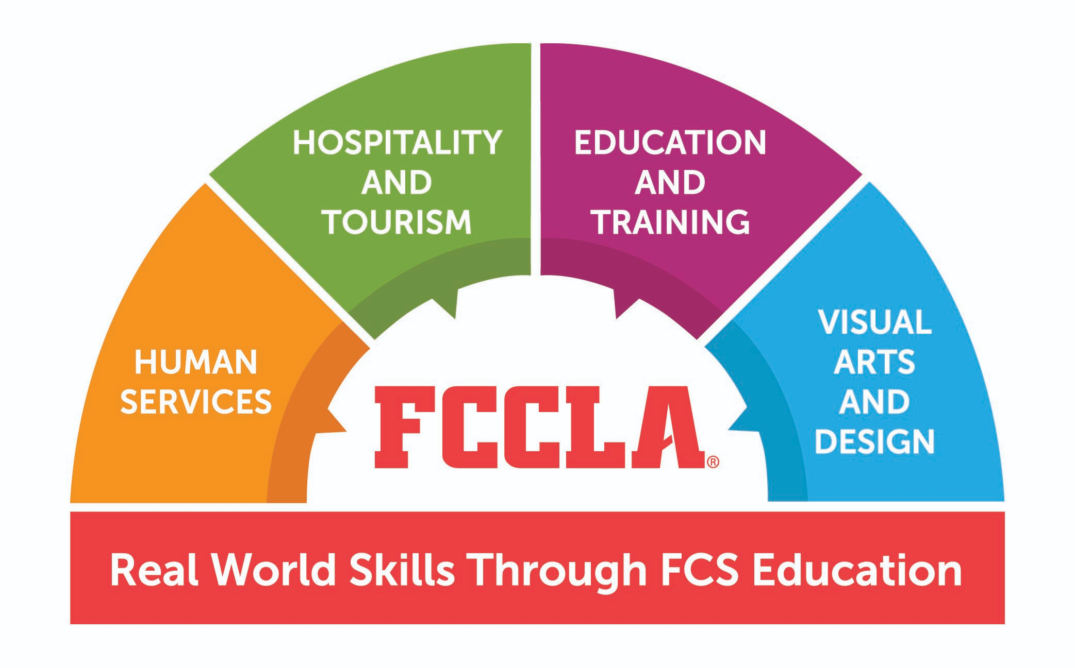
FCCLA
Family Career Community Leaders of America

Slide 2
Why Join
Join more than 175,000 middle and high school members from 5,300 chapters across 50 state associations, Puerto Rico, and the Virgin Islands in the Ultimate Leadership Experience! FCCLA equips members with real world skills through Family and Consumer Sciences (FCS) education by preparing members for careers through its four Career Pathways: Human Services, Hospitality and Tourism, Education and Training, and Visual Arts and Design.

Slide 3
Why Join
FCCLA members will strengthen skills, forge friendships, and make a positive difference in today’s world through participation in Competitive Events, serving in leadership positions, attending conferences across the nation, networking with youth leaders, and attaining essential college- and career-ready skills.

Slide 4
Career Pathways

Slide 5
Advisor: Jill Farr
Room: S2
Email: FarrJ@dvsd.org

